Slide 1


Language Translator
from Hindi to English
Team Mentor: Mr. Thulasiram
Coordinator: Snehal Tambe
Team Members: Parth Sethi
Rohit Kumar
Rohan Kumar

Slide 2
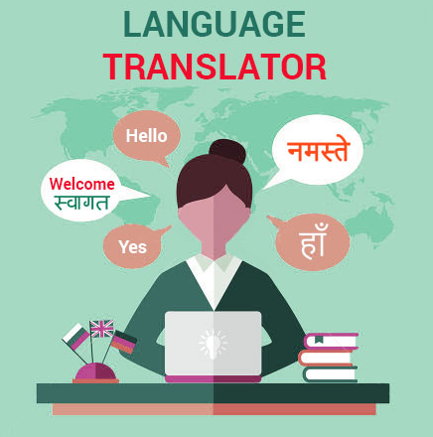
Outline
Introduction
Problem Statement
Objectives
Project Architecture
Data Collection and Cleaning
Exploratory Data Analysis
Word Embedding and Visualization
Model Building
Model Evaluation
Deployment using Streamlit
Technology Stack
Conclusion
Future Scope

Slide 3




Introduction:
Translating hindi stories into english.
Use of different models.
Translation quality
Deployment

Slide 4
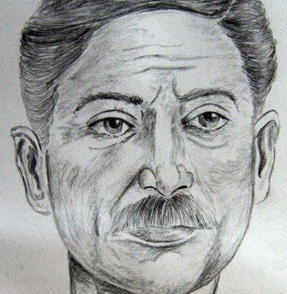

Problem Statement:
A famous publication XYZ, is trying to outperform its rival company by publishing works of the famous Hindi novelist, Munshi Premchand from Hindi to English in a limited time frame.

Slide 5

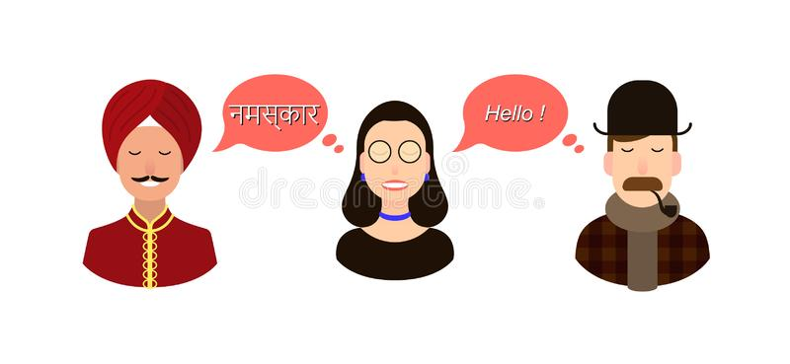
Objectives:
To come up with a language translator model that can create a draft.

Slide 6

Major Problem:

Slide 7

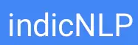



Slide 8
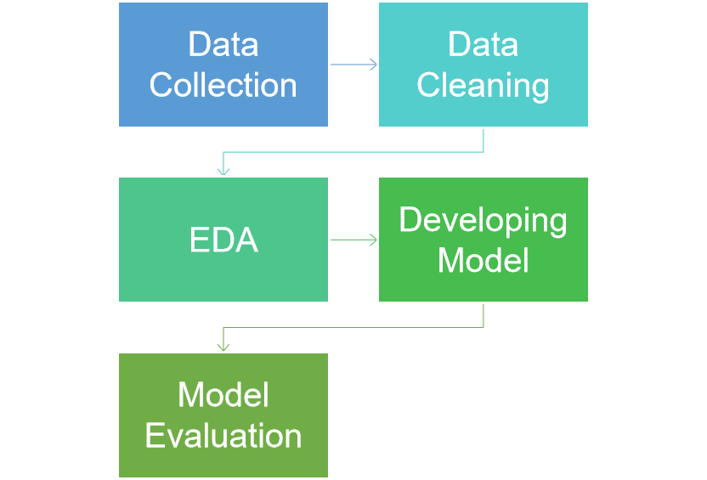

Project Architecture:

Slide 9

Data Collection:
Hindi Story of Munshi Premchand has been taken from this site.
http://premchand.kahaani.org/2009/09/contents.html
Reference literature of the translated Hindi stories were taken from this site.
http://www.columbia.edu/itc/mealac/pritchett/00urdu/kafan/translation_kafan.html
https://www.arvindguptatoys.com/arvindgupta/premchand11.pdf

Slide 10
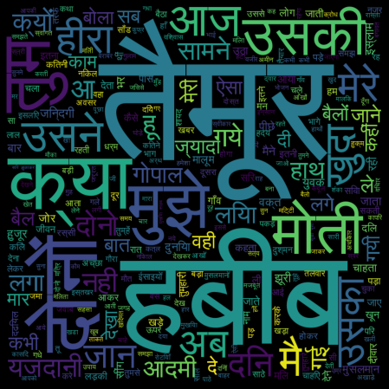

Exploratory Data Analysis:
Word Cloud of PremChand Stories

Slide 11
Model Building and Evaluation:
The team decided to create 3 machine learning model for the purpose of translating Hindi literature to English.
We used BLEU score to evaluate all the three model. BLEU score is shared in the table below.
Model Name | BLEU Score
IndicTrans Model | 0.62
Helsinki Model | 0.55
Salesken Model | 0.408

Slide 12
More about IndicTrans:
IndicTrans is a Transformer-4x model trained on samantar dataset.
The model can perform translations for 11 languages.
It is trained on samantar dataset.
In order to know more about the model you can follow this link IndicTrans' reference .

Slide 13

What is BLEU score?
BLEU is the abbreviation for Bilingual Evaluation Understudy.
To get BLEU score a reference text and translate text is used. BLEU score falls in the range of 0 to 1.

Slide 14
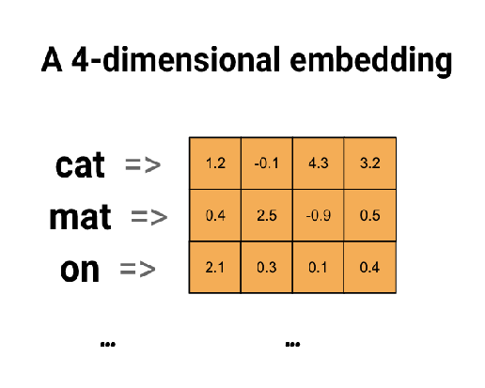

Word Embeddings
Word Embeddings refers to the vector representation of a word.
We used Word2Vec’s CBOW model for training our literature and obtain it’s embeddings.

Slide 15
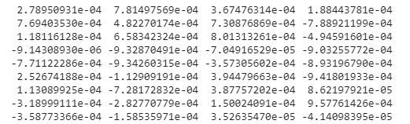
Visualization
Embeddings visualization was done using: https://projector.tensorflow.org.
For visualization we used word embeddings and vocabulary that we obtained from our embedding model.
Below is a snippet of embedding for word भूख.
.

Slide 16
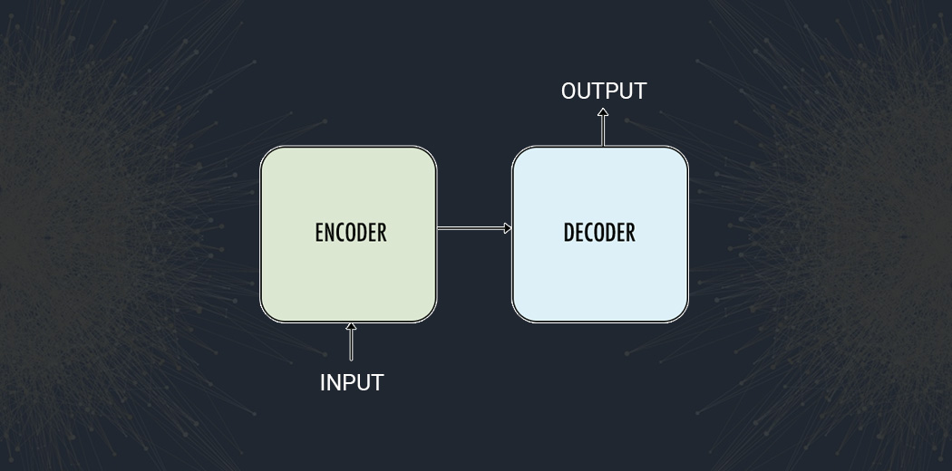
Custom LSTM model

Slide 17
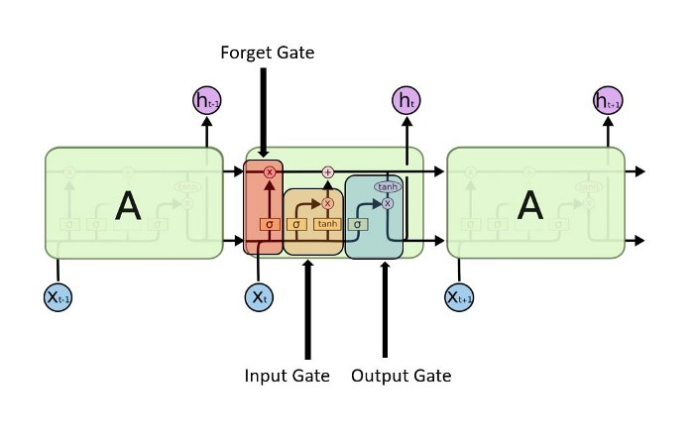
LSTM (Long Short Term Memory)

Slide 18
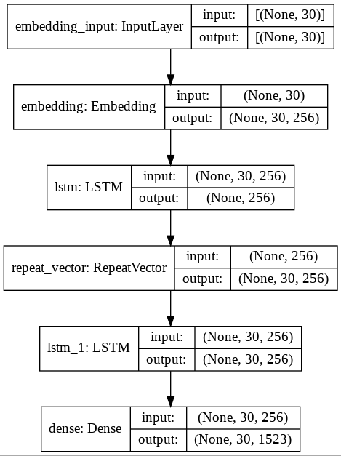
Custom LSTM model

Slide 19
Comparison:
 |  | INDIC Trans | Helsinki | Salesken | Custom LSTM
BLEU SCORE |  | 0.62 | 0.55 | 0.408 | 0.159
ROUGE SCORE | Recall | 0.18 | 0.012 | 0.37 | 0.25
 | Precision | 0.42 | 0.7142 | 0.45 | 0.153
JACCARD SIMILARITY METRICS | Accuracy | 32.81 | 42.36% | 33.04% | 42.86%
 | Precision | 54.70 | 64.85% | 53.47% | 42.86%
TF IDF Similarity |  | 91.8 | 87.6658 % | 92.2328 % | 65.5308 %
EMBEDDING FASTTEXT Similarity |  | 81.46% | 80.39% | 81.38% | 36.06%
EMBEDDING GLOVE Similarity |  | 92.92% | 92.21% | 93.21% | 37.25%

Slide 20
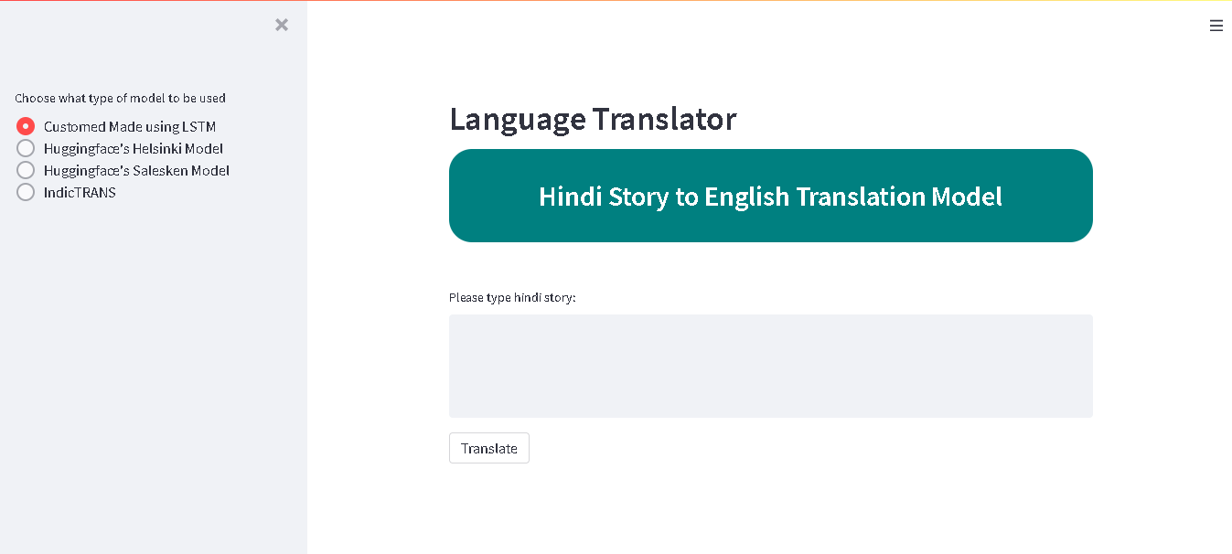
Streamlit:
Notes:
Streamlit is an open-source python library that makes it easy to create and share beautiful, custom web apps for machine learning and data science.

Slide 21
Technology Stack:
Element | Description
Pandas | Python library used for data manipulation & analysis.
Numpy | Used to perform a wide variety of mathematical operations on arrays.
Wordcloud | It is a data visualization technique used for representing text data in which the size of each word indicates its frequency or importance.
NLTK | Python package used for Natural Language Processing (NLP).
Sklearn | Used for model building and evaluation using various metrics.
Pickle | Used to dump/load a model or any python object.
Streamlit | Used to create and share beautiful, custom web apps for machine learning and data science.
Embedding | Used for vector space models.
Indic Trans | Used for Language Translation.
Hugging Face | Transformer Library.

Slide 22
Conclusion:
Our goal in introducing machine translation was to increase scalability and better serve the customers. Advantages include:
Reducing translation time.
Increasing content freshness.
Reinvesting savings into high-value content and products.

Slide 23
Future Scope:
We envision extending Machine Translation to other languages.
Machine Translation API.
Plugin to track quality of translation.
Build more complex model.

Slide 24
Questions?

Slide 25
Thank You

